Slide 1

AI training group
Weekly Report
Nguyen khai phu – Nov 3 2023

Slide 2
Last week
ISP008 foundation
Modified deepSBD
Layer | Feature map
Data | 3 x 16 x 64 x 64
Conv3d_1 + BatchNorm+ MaxPool | 32 x 12 x 15 x 15
Conv3d_2 + BatchNorm+ MaxPool | 64 x 8 x 3 x 3
Conv3d_3 + BatchNorm | 256 x 8 x 3 x 3
Conv3d_4 + BatchNorm | 512 x 8 x 3 x 3
Conv3d_5 + BatchNorm | 256 x 8 x 3 x 3
Linear + sigmoid | 1
Data: 602 positives and 602 negatives
2
CISP-1352-A21 - ISP-DOC-STYLETYPE-Templates © Robert Bosch GmbH 2016. All rights reserved, also regarding any disposal, exploitation, reproduction, editing, distribution, as well as in the event of applications for industrial property rights.

Slide 3
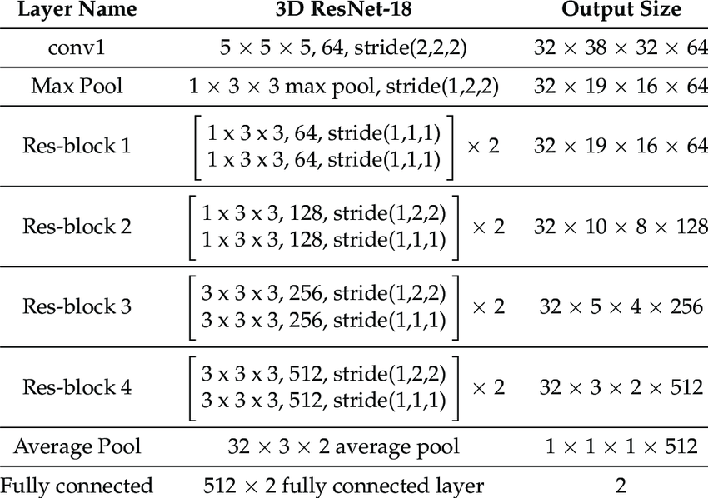
Finetune Resnet3D
ISP008 foundation
Backbone: R3D-18 pretrained on KINETICS400 dataset (action recognition, 400 classes)
Layer
Linear (512, 256), LRelu, BatchNorm3D, Dropout(0.5)
Linear (256, 64), LRelu, BatchNorm3D, Dropout(0.3)
Linear (64, 1), Sigmoid
Classifier
3D ResNet-18
2
CISP-1352-A21 - ISP-DOC-STYLETYPE-Templates © Robert Bosch GmbH 2016. All rights reserved, also regarding any disposal, exploitation, reproduction, editing, distribution, as well as in the event of applications for industrial property rights.

Slide 4
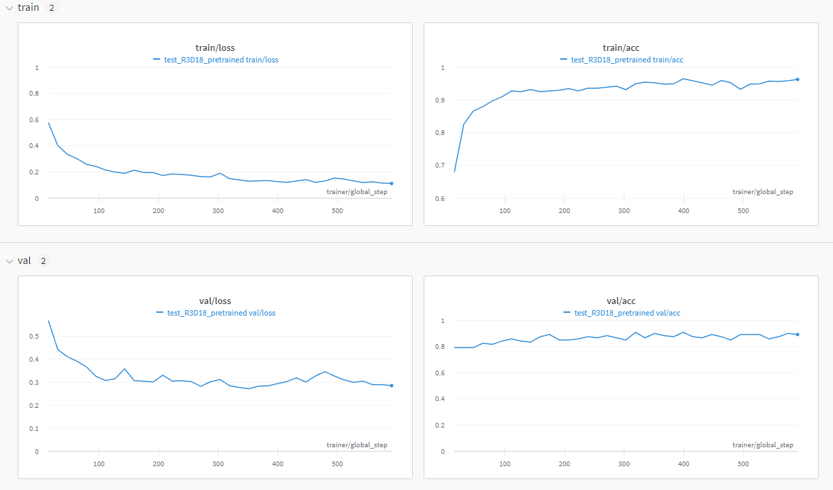
Finetune Resnet3D
ISP008 foundation
Split ratio: 8:1:1
Batch size: 64
Early stop & reduce LR
Best performance (epoch 24):
train/loss = 0.1263
train/acc = 0.9647
val/loss = 0.2937
val/acc = 0.9083
Test performance:
acc = 83.5%
prec = 86%
rec = 80%
F1 = 83%
2
CISP-1352-A21 - ISP-DOC-STYLETYPE-Templates © Robert Bosch GmbH 2016. All rights reserved, also regarding any disposal, exploitation, reproduction, editing, distribution, as well as in the event of applications for industrial property rights.

Slide 5
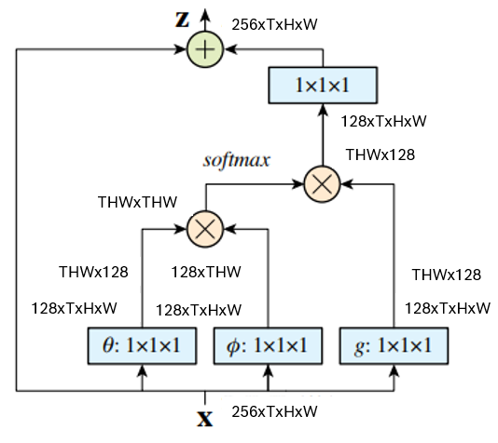
3D CNN with Non-local block
ISP008 foundation
Layer | Feature map
Data | 3 x 16 x 64 x 64
Conv3d_1 + BatchNorm+ MaxPool | 32 x 12 x 15 x 15
Conv3d_2 + BatchNorm+ MaxPool | 64 x 8 x 3 x 3
Conv3d_3 + BatchNorm | 256 x 8 x 3 x 3
Conv3d_4 + BatchNorm | 512 x 8 x 3 x 3
Conv3d_5 + BatchNorm + AvgPool | 256 x 6 x 1 x 1
Non-local block | 256 x 6 x 1 x 1
Linear + sigmoid | 1
Non-local block
2
CISP-1352-A21 - ISP-DOC-STYLETYPE-Templates © Robert Bosch GmbH 2016. All rights reserved, also regarding any disposal, exploitation, reproduction, editing, distribution, as well as in the event of applications for industrial property rights.

Slide 6
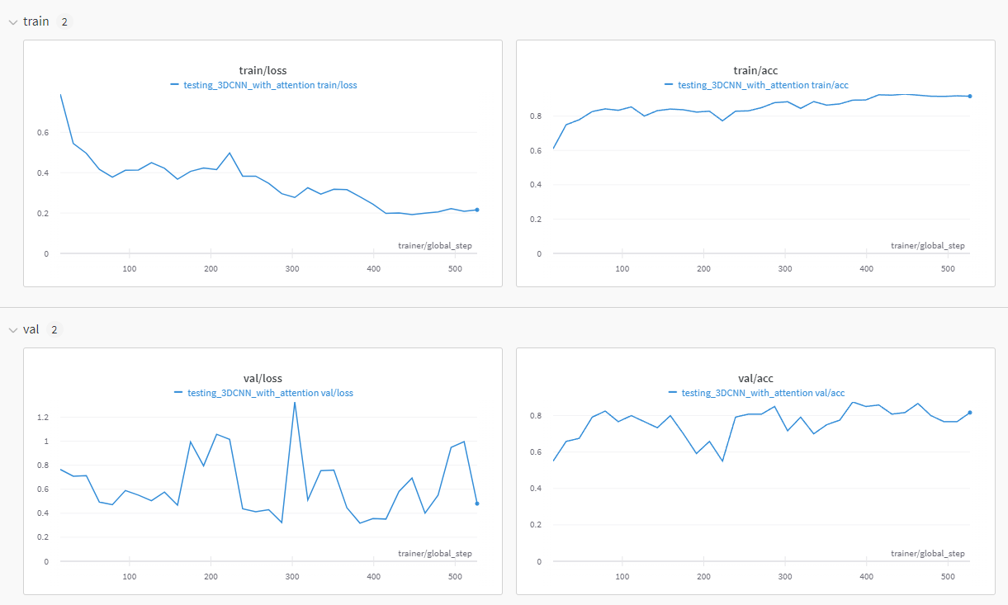
Training results
ISP008 foundation
Split ratio: 8:1:1
Batch size: 64
Early stop & reduce LR
2
CISP-1352-A21 - ISP-DOC-STYLETYPE-Templates © Robert Bosch GmbH 2016. All rights reserved, also regarding any disposal, exploitation, reproduction, editing, distribution, as well as in the event of applications for industrial property rights.

